Slide 1

GUI FOR FITNESS CALCULATOR
PROJECT REPORT
INT 213
SUBMITTED TO:MR.ISHAN KUMAR
DEPT.OF.CSE
.

Slide 2
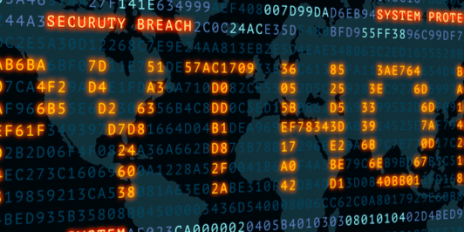
AGENDA
INTRODUCTION
PROJECT
FLOW DIAGRAMS
RESULTS

Slide 3
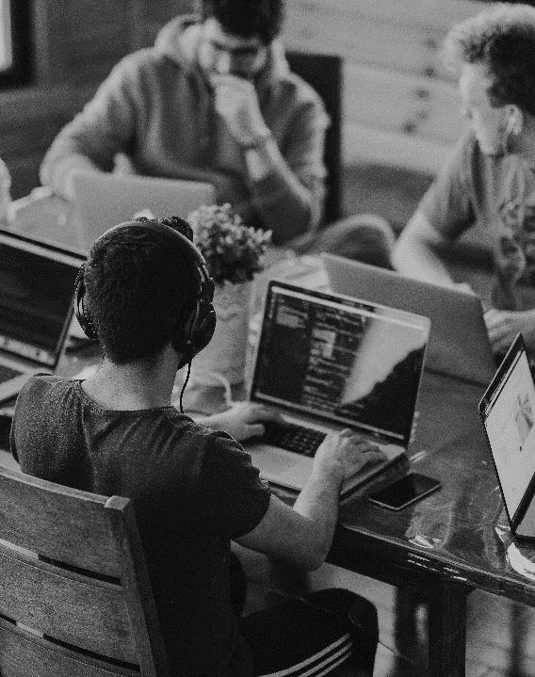
INTRODUCTION
……………………………………………………………
Project allocated to our team is Fitness Calculator. It is a Single User This Mini project of “Fitness Calculator” is purely made in python, with a good user-friendly interface which lets the user to enter the various values required to be input in order to calculate how fit the person is. The main window consists of all the entry fields that the user is required to fill in order to generate a report. This main window also has a button to generate report when all the entry box has the required values. Program which generates report of the particular person with following labels:

Slide 4
introduction
• BMI
• Blood Pressure
• Pulse Rate
• RBC, WBC, Platelets Count
• Hemoglobin level
• Uric Acid level
• Cholesterol level and categorize it as high, low and medium.
These different values are colored according to how harmful they are on the individual’s health. This makes it easier for the user to view the report, moreover “tk” module of tkinter library is used to show these values as a progress making it easier for the person using the app.

Slide 5
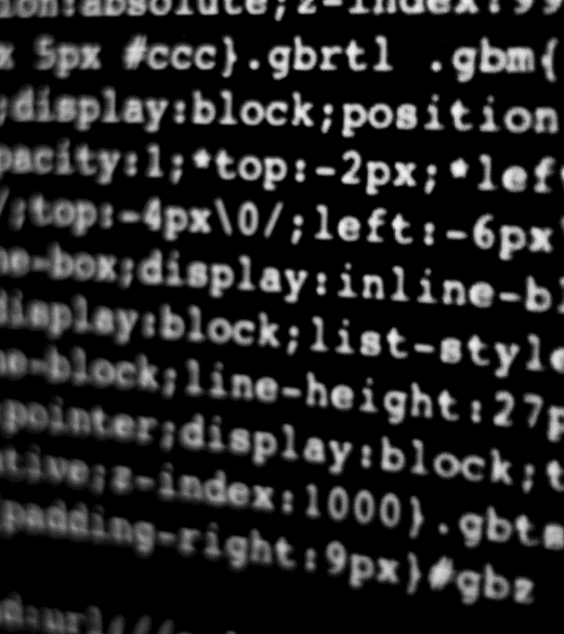
project
…………………………………

Slide 6
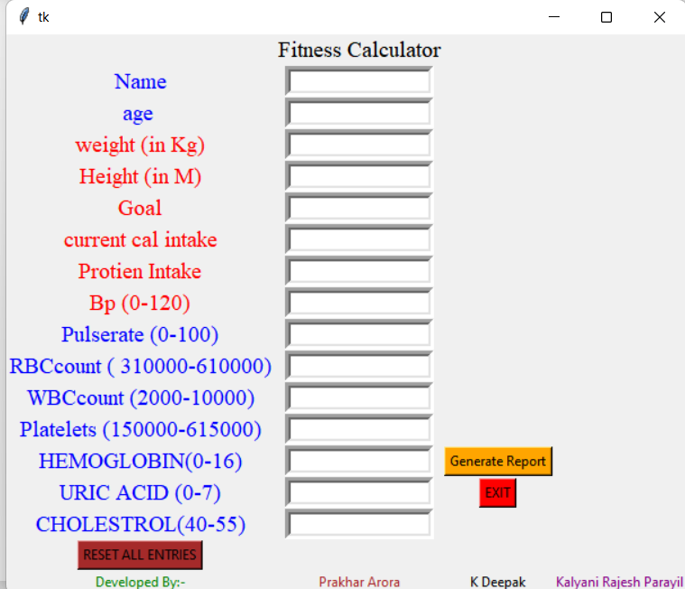
Fitness calculator

Slide 7
…………………………………………………….
This Mini project of "Fitness Calculator" is purely made in python, with a good user-friendly interface which lets the user to enter the various values required to be input in order to calculate how fit the person is.
The main window consists of all the entry fields that the user is required to fill in order to generate
a report. This main window also has a button to generate report when all the entry box has the
required values.

Slide 8
…………………………………………………
Program which generates report of the particular person with following labels:
. BMI
⚫️ Blood Pressure • Pulse Rate
RBC, WBC, Platelets Count
Hemoglobin level Uric Acid level
Cholesterol level
and categorize it as high, low and medium.
These different values are colored according to how harmful they are on the individual's health. This makes it easier for the user to view the report, moreover "tk" module of tkinter library is used to show these values as a progress making it easier for the person using the app.

Slide 9
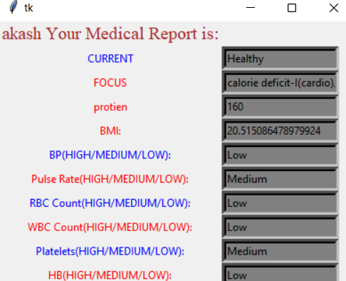
………………………………………………………….

Slide 10
…………………………………………………………
Program used a bunch of if statements used to decide the output according to the input given by user.
This is the basic logic on which the program works. The goal is considered and the current calorie and protein intake are also taken into account The calculation of BMI and other values is done by using formulas and data collected from various websites is used to calculate the strength of a particular value in terms of High low or medium
There are various functions and if statement which also control what color to change for the label
when a certain value is entered.

Slide 11
…………………………………………………………
BASIS OF CALCULATION MODULES:
BMI
18.5 – 24.9
BMI =weight (kg) height (m²)
25.0-29.9 = overweight
30.0 and up=Very overweight
Blood pressure
130<= high
80=medium
90>=low
Pulse Rate
100<=high
60-100=medium
50> = low

Slide 12
……………………………………………………..
RBC count
Below 475000 = low
475000-610000=medium
WBC count
<4000=low
4000-10000=medium
Platelet count
<150000=low
150000-450000=medium
Haemoglobin
<12=low
12-16=medium
Uric acid
<4=low
4-7=medium
Cholestrol
<40=low
40-50=medium

Slide 13
screenshots

Slide 14
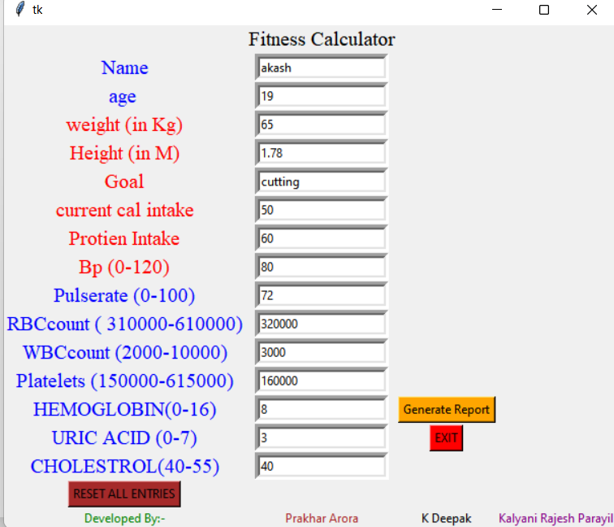
.

Slide 15
.

Slide 16
THANKYOU
KALYANI RAJESH PARAYIL
PRAKHAR ARORA
K.DEEPAK

